Slide 1


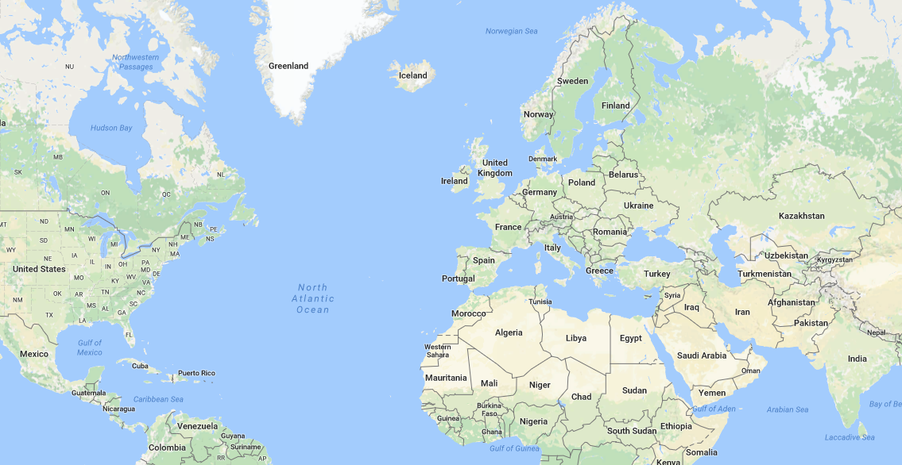
LOGO
LOGIN WITH:
TRIP TIP
Stuff about what the service is and what you can do… Stuff about what the service is and what you can do…
Stuff about what the service is and what you can do… Stuff about what the service is and what you can do…
Stuff about what the service is and what you can do… Stuff about what the service is and what you can do…
Stuff about what the service is and what you can do… Stuff about what the service is and what you can do…
Stuff about what the service is and what you can do… Stuff about what the service is and what you can do…
Stuff about what the service is and what you can do… Stuff about what the service is and what you can do…
Stuff about what the service is and what you can do… Stuff about what the service is and what you can do…
Stuff about what the service is and what you can do… Stuff about what the service is and what you can do…

Slide 2
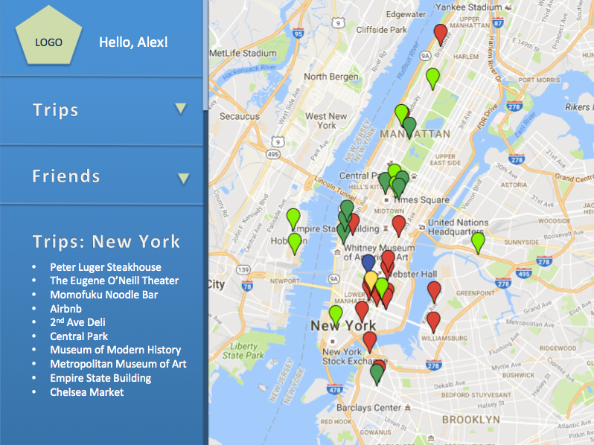
LOGO
LOGIN WITH:
View Trips

Slide 3
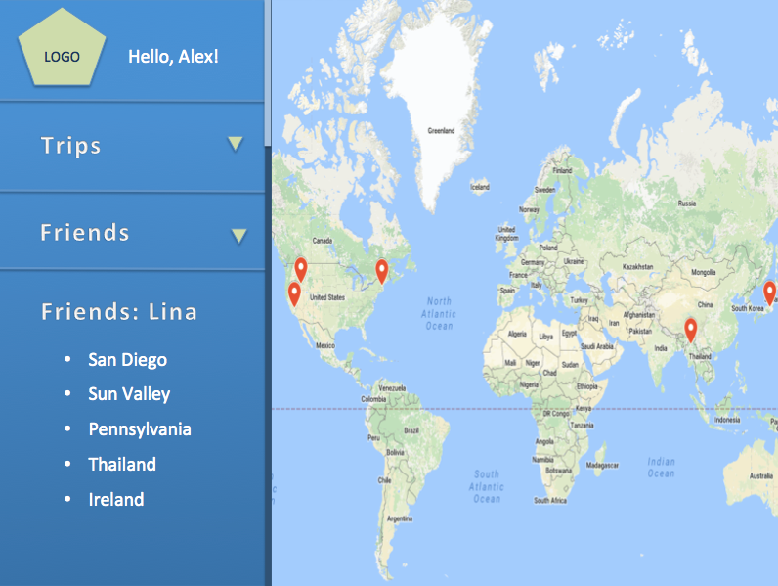
LOGO
LOGIN WITH:
See friends’ travels

Slide 4
LOGO
LOGIN WITH:
Photos
Screenshot of what a photo looks like

Slide 5

LOGO
Hello, Alex!
Trips
Friends

Slide 6
LOGO
Hello, Alex!
Trips
+ Create Trip
New York
Italy
Boston
San Diego
China
Japan
Friends

Slide 7
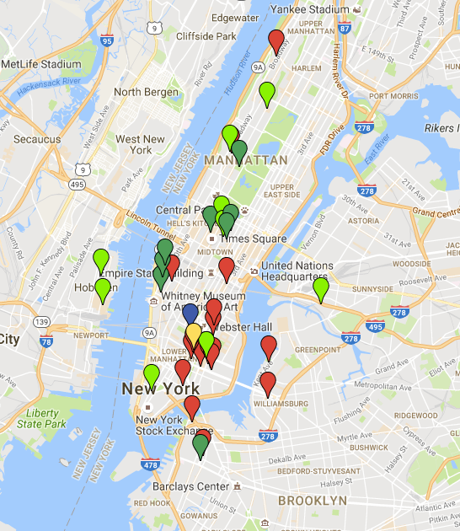
LOGO
Hello, Alex!
Trips
Friends
Trips: New York
Peter Luger Steakhouse
The Eugene O’Neill Theater
Momofuku Noodle Bar
Airbnb
2nd Ave Deli
Central Park
Museum of Modern History
Metropolitan Museum of Art
Empire State Building
Chelsea Market

Slide 8
LOGO
Hello, Alex!
Trips
2nd Ave Deli
123 Post St. 11849
Yelp rating: ★★★★★
User rating: ★★★★
Friends
Trips: New York
Peter Luger Steakhouse
The Eugene O’Neill Theater
Momofuku Noodle Bar
Airbnb
2nd Ave Deli
Central Park
Museum of Modern History
Metropolitan Museum of Art
Empire State Building
Chelsea Market

Slide 9
LOGO
Hello, Alex!
2nd Ave Deli
(212) 242-1352
123 Post St. 11849
Yelp rating: ★★★★★
User rating: ★★★★
Your notes:
This was a great deli. The wait was pretty long but it was worth it. I got a pastrami sandwich and soup split pea soup, which was great.
Trips
Friends
Trips: New York
Peter Luger Steakhouse
The Eugene O’Neill Theater
Momofuku Noodle Bar
Airbnb
2nd Ave Deli
Central Park
Museum of Modern History
Metropolitan Museum of Art
Empire State Building
Chelsea Market

Slide 10
LOGO
Hello, Alex!
Trips
Friends

Slide 11
LOGO
Hello, Alex!
Trips
Friends
+ Add Friend
Lina C.
Jason B.
Bradley I.
Stu J.
Jordan K.
Rae B.

Slide 12
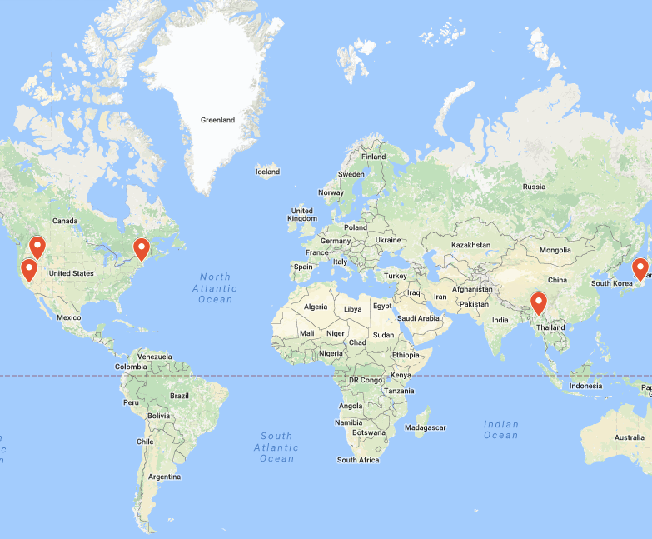
LOGO
Hello, Alex!
Trips
Friends
Friends: Lina
San Diego
Sun Valley
Pennsylvania
Thailand
Ireland

Slide 13
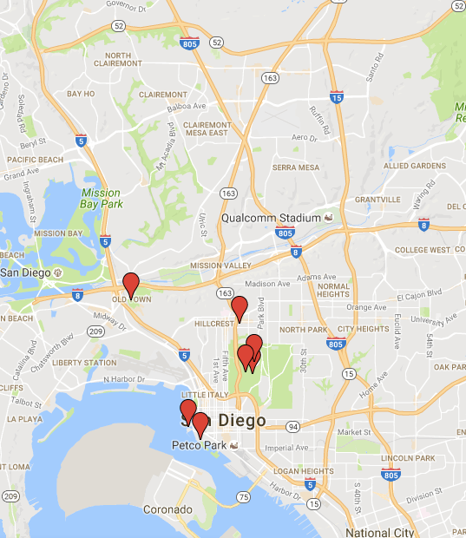
LOGO
Hello, Alex!
Trips
Friends
Friends: Lina
Lina: San Diego
The Prado at Balboa Park
100 Wines Kitchen
Old Town
San Diego Zoo
USS Midway Museum
Seaport Village
San Diego Museum of Man

Slide 14
LOGO
Hello, Alex!
Trips
Seaport Village
123 Post St. 11849
Yelp rating: ★★★★
User rating: ★★★★
Friends
Friends: Lina
Lina: San Diego
The Prado at Balboa Park
100 Wines Kitchen
Old Town
San Diego Zoo
USS Midway Museum
Seaport Village
San Diego Museum of Man

Slide 15
LOGO
Hello, Alex!
Seaport Village
(925) 242-1352
123 Post St. 83109
Yelp rating: ★★★★
User rating: ★★★★
Your notes:
Make sure you check out the statue in the back, it’s very cool!
Trips
Friends
Friends: Lina
Lina: San Diego
The Prado at Balboa Park
100 Wines Kitchen
Old Town
San Diego Zoo
USS Midway Museum
Seaport Village
San Diego Museum of Man

Slide 16
LOGO
Hello, Alex!
Trips
Friends

Slide 17
LOGO
Hello, Alex!
Trips
+ Create Trip
New York
Italy
Boston
San Diego
China
Japan
Name your trip
ADD
Friends

Slide 18
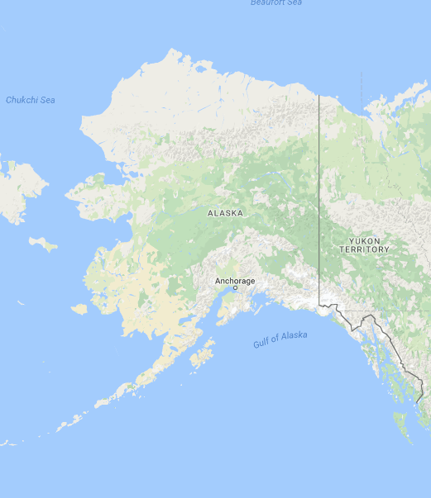
LOGO
Hello, Alex!
Trips
Friends
Trips: Alaska
Search to add
ADD

Slide 19
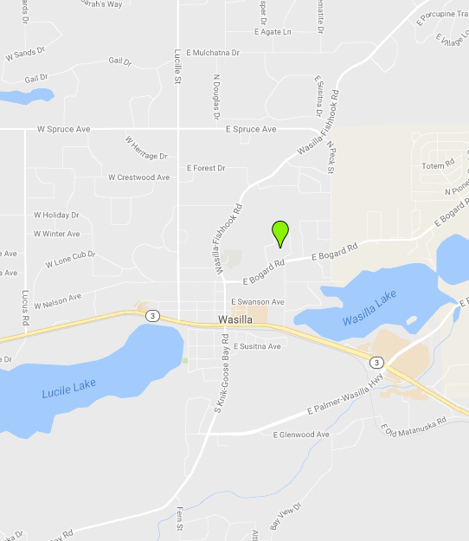
LOGO
Hello, Alex!
Trips
Mr. Bob’s Burger’s
123 Post St. 12034
Yelp rating: ★★★★★
User rating: ★★★★★
+
Friends
Trips: Alaska
Enter a location
Search

Slide 20
LOGO
Hello, Alex!
Trips
Friends
Trips: Alaska
Enter a location
Search
Mr. Bob’s Burgers

